Slide 1
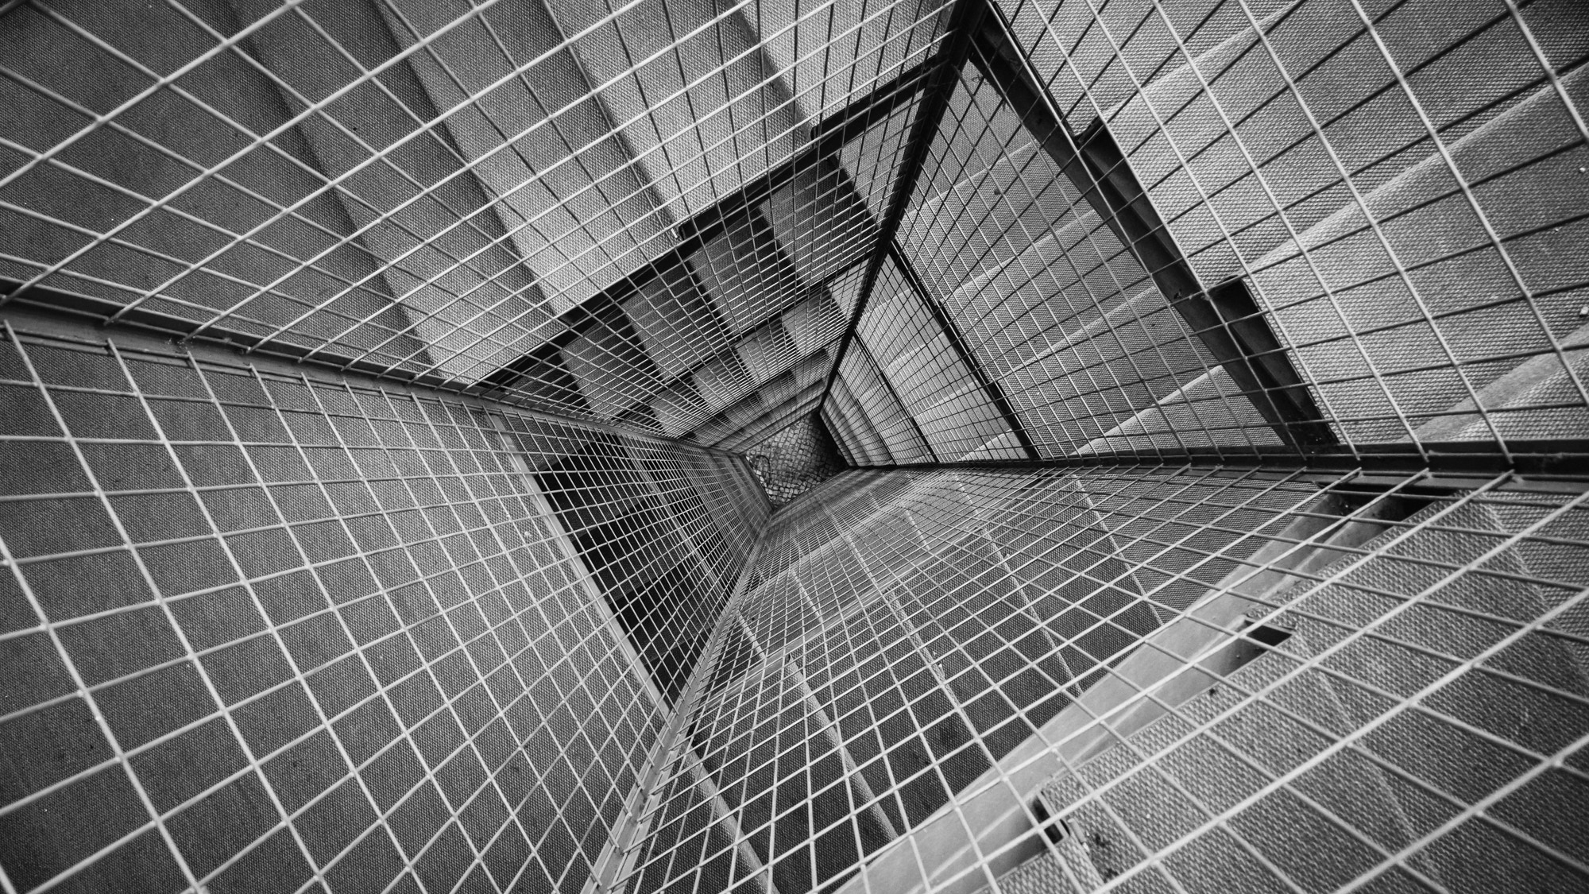
MACHINERY MONITORING SYSTEM.
AN ANDROID APP
DONE BY :
CH.MOHAN TEJA (315126510194)
B.VINAY (315126510189)
M.G.K.RAJU (315126510211)

Slide 2
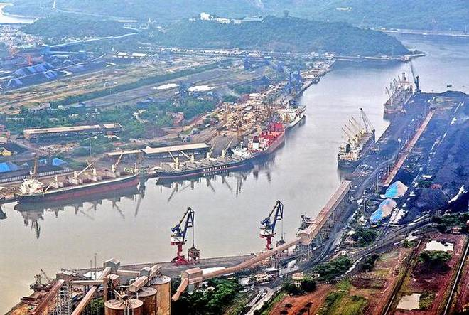
VIZAG PORT
2ND LARGEST PORT IN INDIA
ANNUAL CARGO TONNAGE: 58.2 BILLION KG
ANNUAL REVENUE : ₹660 CRORES
EMPLOYEES WORKING : 4000 APPROX.
MACHINERY : TUGS, BG LOCOS , CRANES , PUMP HOUSES , FLOATING CRAFTS ETC..,

Slide 3
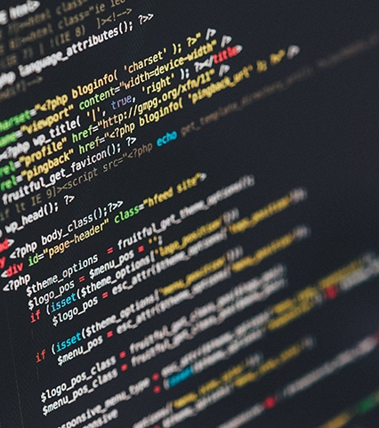
MODERNIZATION
OF VISHAKAPATNAM PORT

Slide 4
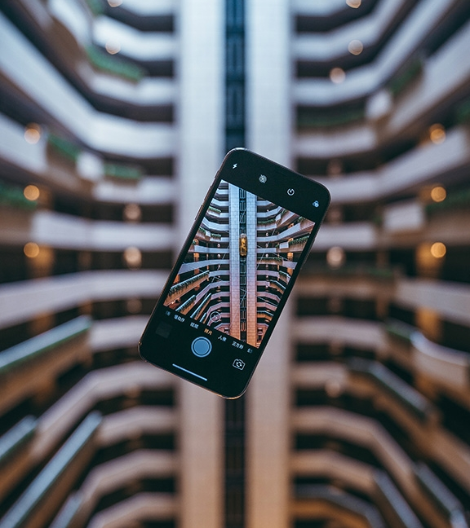
REQUIREMENT FOR THE APP
REPAIR OR FAILURE OF MACHINERY.
AVAILABILITY OF MACHINERY.
REDUCE PAPER WORK.
INCREASE PRODUCTIVITY .
INCREASE IN USAGE OF HANDHELD DEVICES.
EMPLOYEES SHOWING INTEREST TO WORK THROUGH DEVICES WHICH ARE PORTABLE ,HAND HELD .

Slide 5
DESIGNING THE APP
MODULES:
CREATE A DATABASE THAT HOLDS DETAILS OF EVERY CATEGORY OF MACHINERY WITH SHIFTS AND QUANTITYS AVAILABLE,AREA OF WORKING ETC.
PHP SCRIPT THAT INTERACTS WITH DATABASE ON APP REQUESTS.
ANDROID APP LOGIC THAT DISPLAYS THE DATA PROVIDED BY THE PHP SCRIPTS.
DESIGN OF SOPHISTICATED UI FOR THE ANDROID APP.

Slide 6
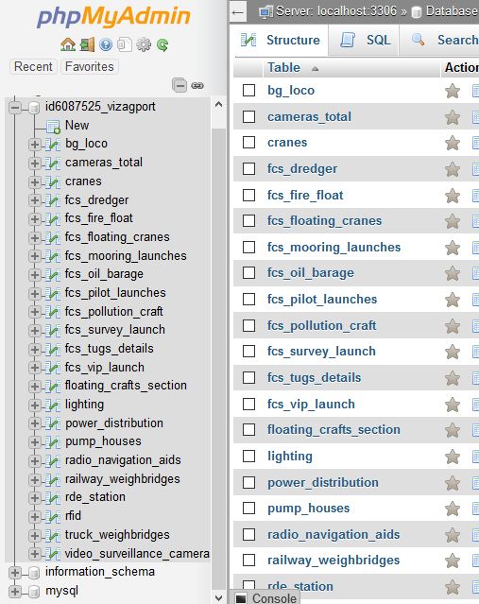
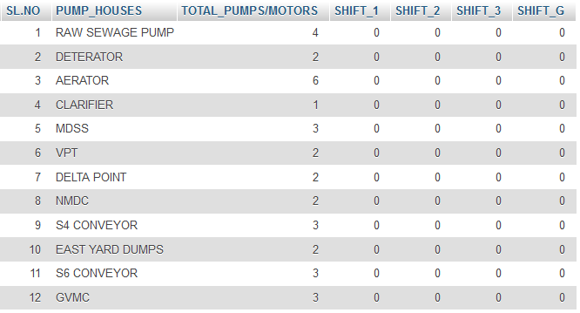
DATABASE
SAMPLE TABLE: PUMP HOUSE

Slide 7
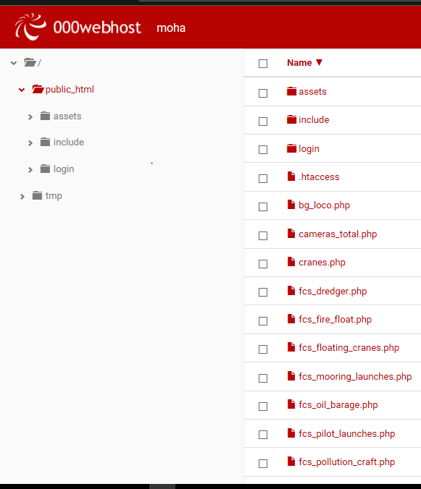
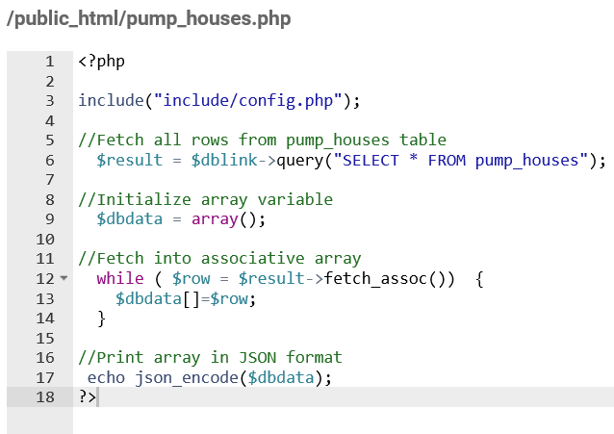
PHP THAT ECHOES:
AN IMPORTANT BLOCK OF CODE:

Slide 8
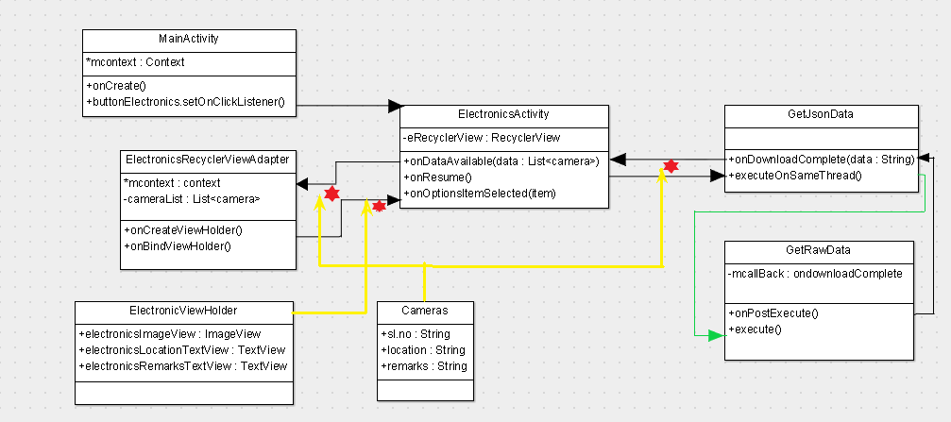
CLASS DIAGRAM

Slide 9
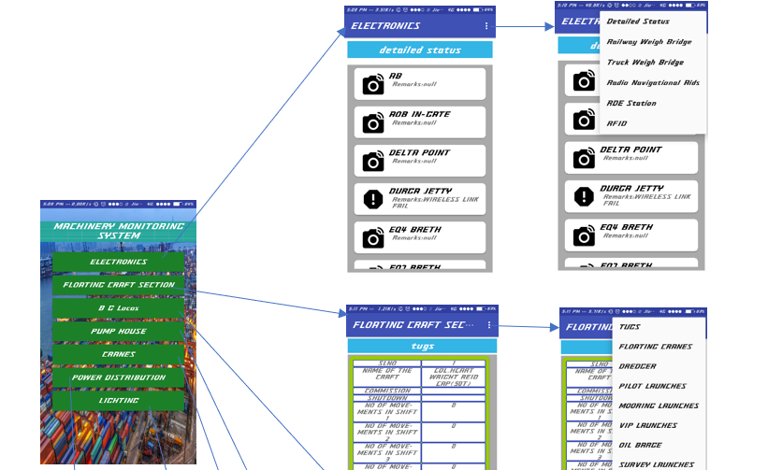
APP LAYOUT :

Slide 10



THANK YOU
WWW.ANITS.EDU.IN
MOHAN TEJA
+91 9951227331
mtkernelprogramming@gmail.com
Code is available at github link: https://github.com/mohanteja1/VizagPortTrust

